Slide 1
Sequences and Time-Series in Medicine July 25, 2020
Applied Data Science
MMCi Term 4
Matthew Engelhard
Notes:
NEED INFO ABOUT ROC, CONFUSION MATRIX, ETC HERE

Slide 2
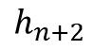
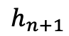
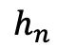
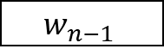
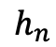
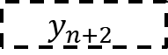
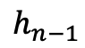
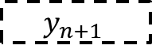
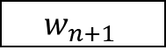
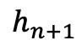

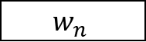
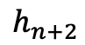
Deidentification via Recurrent Neural Network…
Sequence of Word
Embeddings (sentence)
Model-Predicted
PHI Status
$$h_{n−1}$$
Neural
Network
$$h_{n}$$
$$w_{n−1}$$
Softmax
$$y_{n}$$
$$h_{n}$$
Neural
Network
$$h_{n+1}$$
$$w_{n}$$
Softmax
$$y_{n+1}$$
$$h_{n+1}$$
Neural
Network
$$w_{n+1}$$
Softmax
$$y_{n+2}$$
$$h_{n+2}$$
Notes:
We saw how this architecture could be used to predict the next word in the sequence, for example
Here, the goal is to classify each word in the sequence is classified as being PHI – one of several types – or not
in a way that’s not just informed by the embedding for that individual word, but by surrounding context

Slide 3
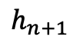
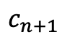

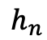
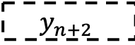
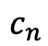
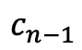
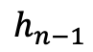
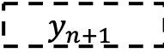

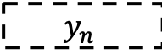
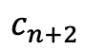

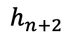
…Specifically, an LSTM
Sequence of Word
Embeddings (sentence)
Model-Predicted
PHI Status
$$c_{n−1}$$
$$h_{n−1}$$
Neural
Network
$$h_{n}$$
$$w_{n−1}$$
Softmax
$$y_{n}$$
$$c_{n}$$
$$h_{n}$$
Neural
Network
$$h_{n+1}$$
$$w_{n}$$
Softmax
$$y_{n+1}$$
$$c_{n+1}$$
$$h_{n+1}$$
Neural
Network
$$w_{n+1}$$
Softmax
$$y_{n+2}$$
$$c_{n+2}$$
$$h_{n+2}$$
Notes:
Long Short Term Memory network – i.e. LSTM
Key is the cell state
Modified in each block by neural network layers that decide what portion of previous should be remembered, what should be forgotten, and what new information should be added

Slide 4


Inside an LSTM
http://colah.github.io/posts/2015-08-Understanding-LSTMs/
Notes:
Good place to write on paper

Slide 5
Modifications to RNN for Deidentification
LSTM provides a more flexible representation of previous context
output and cell state are both passed to the next block
Bidirectional LSTM provides context from subsequent words as well as previous words
Character-level RNN allows a non-trivial representation of out-of-dictionary tokens
Notes:
2 – output from both directions concatenated
3 – character-level RNN acting independently on each word, including in-dictionary words… allows the model to deal with weird tokens, e.g. social security numbers – model could learn that this structure is likely to be PHI

Slide 6
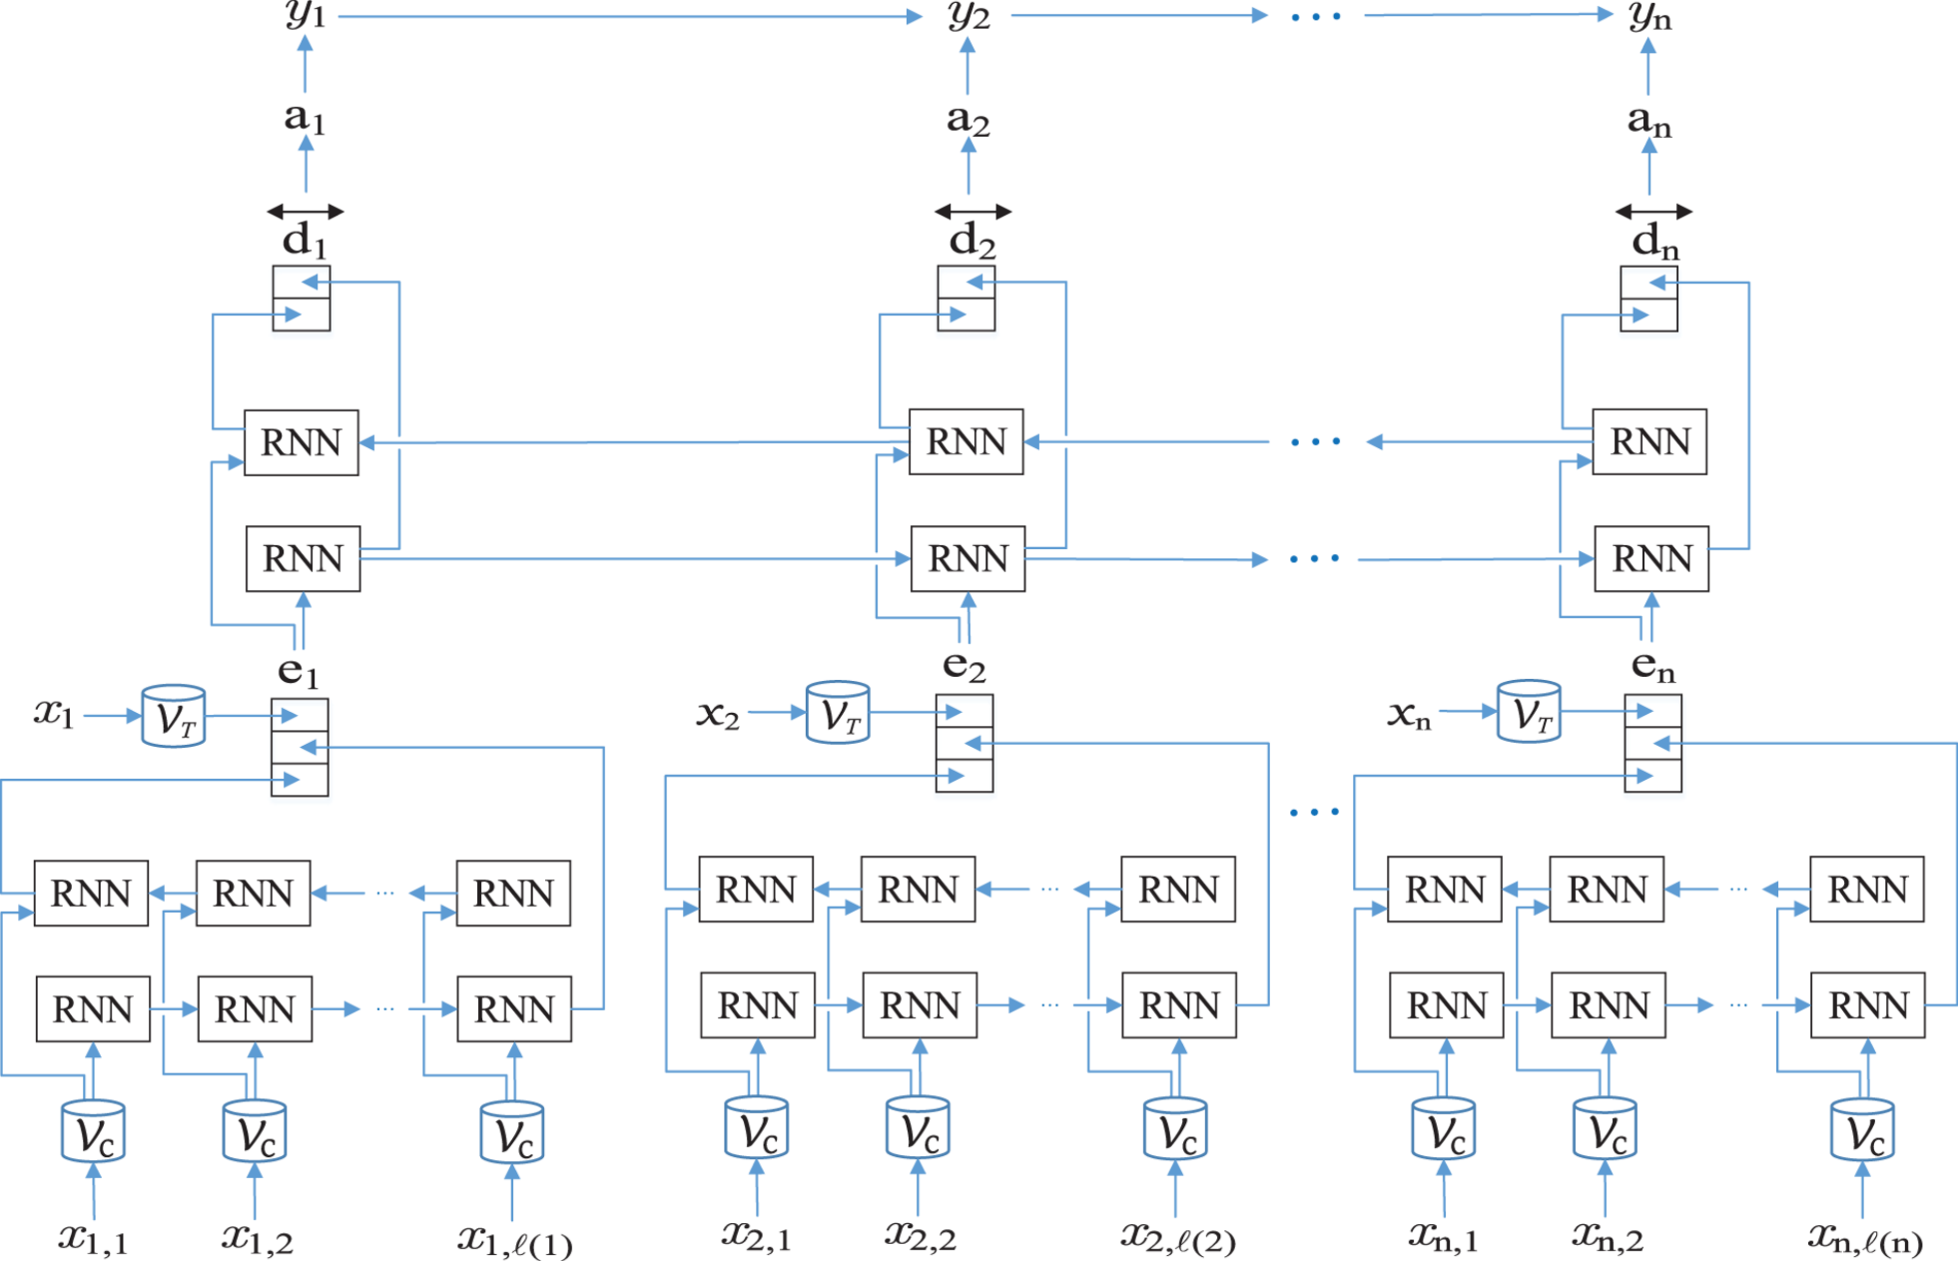
From: De-identification of patient notes with recurrent neural networks
J Am Med Inform Assoc. 2016;24(3):596-606. doi:10.1093/jamia/ocw156
J Am Med Inform Assoc | © The Author 2016. Published by Oxford University Press on behalf of the American Medical Informatics Association. All rights reserved. For Permissions, please email: journals.permissions@oup.com
Notes:
Figure 1. Architecture of the artificial neural network (ANN) model. (RNN, recurrent neural network.) The type of RNN used in this model is long short-term memory (LSTM). n is the number of tokens, and xi is the ith token. VT is the mapping from tokens to token embeddings. ℓ(i) is the number of characters and xi,j is the jth character in the ith token. VC is the mapping from characters to character embeddings. ei is the character-enhanced token embeddings of the ith token. d↔i is the output of the LSTM of the label prediction layer, ai is the probability vector over labels, yi is the predicted label of the i<sup>th</sup> token.
6

Slide 7
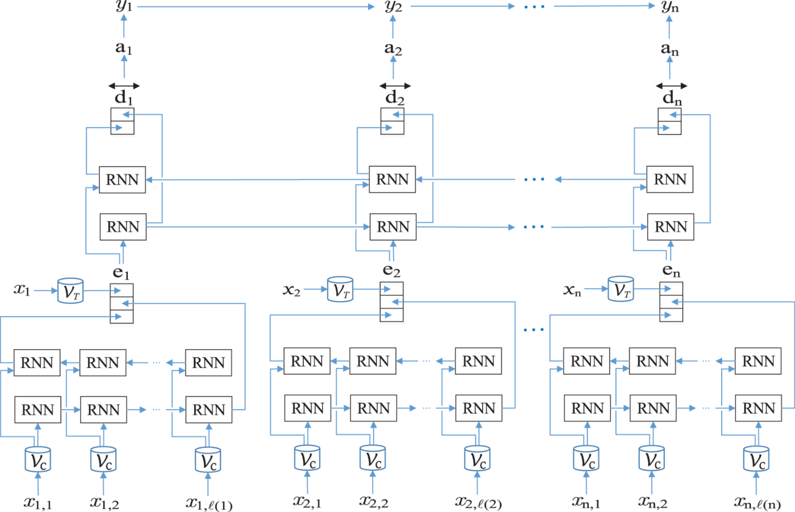
backward token LSTM
backward character LSTM
forward token LSTM
forward character LSTM
Character embedding dimension: 25
Character-based token-embedding LSTM dimension: 25
Token embedding dimension: 100
Label prediction LSTM dimension: 100
Notes:
Note: data scientist will not know whether the set of clinical variables is adequate!

Slide 8
Results
Deidentification of Patient Notes

Slide 9
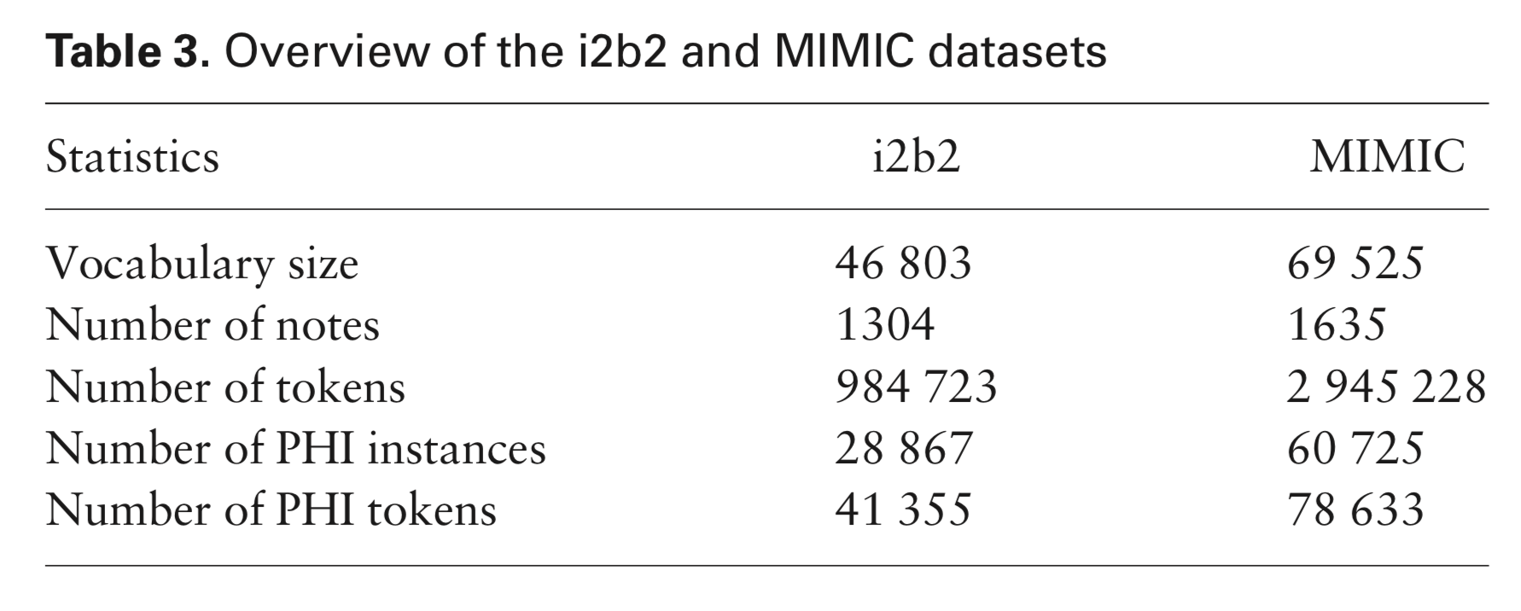
Train, Validation, Test
MIMIC:
80% train/validation
20% test
i2b2:
60% train/validation
40% test
“All results were computed using the official evaluation script from the i2b2 2014 de-identification challenge.”

Slide 10
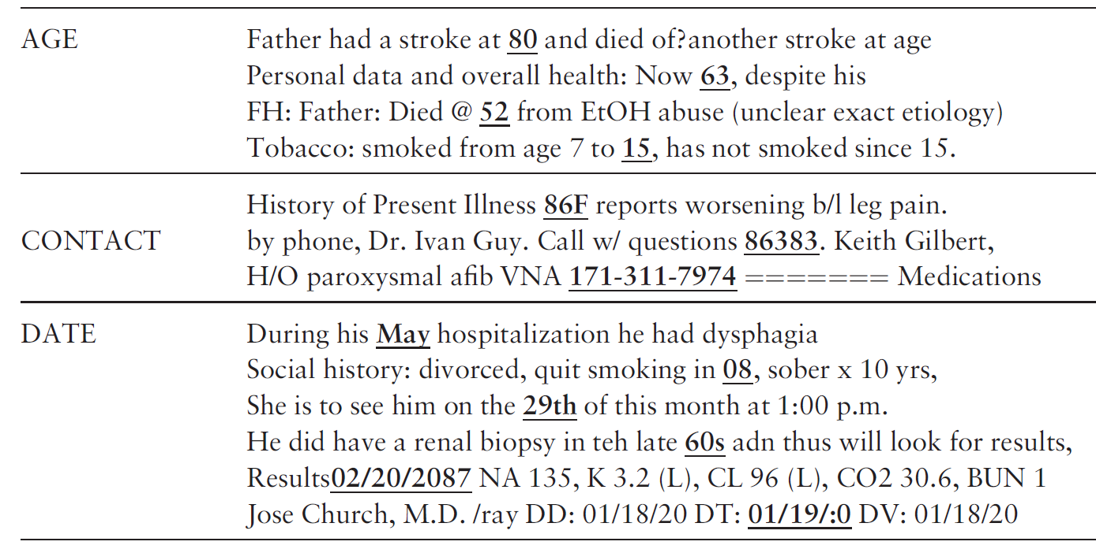
Examples of PHI Identified by the RNN

Slide 11
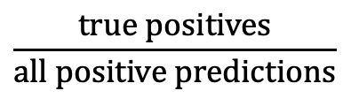
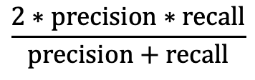
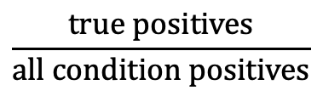
Evaluation Metrics
Precision, or positive predictive value:
Recall, or sensitivity:
F1-score:
 | Condition Positive | Condition Negative
Prediction Positive | True Positive | False Positive
Prediction Negative | False Negative | True Negative
$$\frac{true positives}{all positive predictions}$$
$$\frac{true positives}{all condition positives}$$
$$\frac{2∗precision∗recall}{precision+recall}$$
Notes:
F1-score is harmonic mean of the two

Slide 12
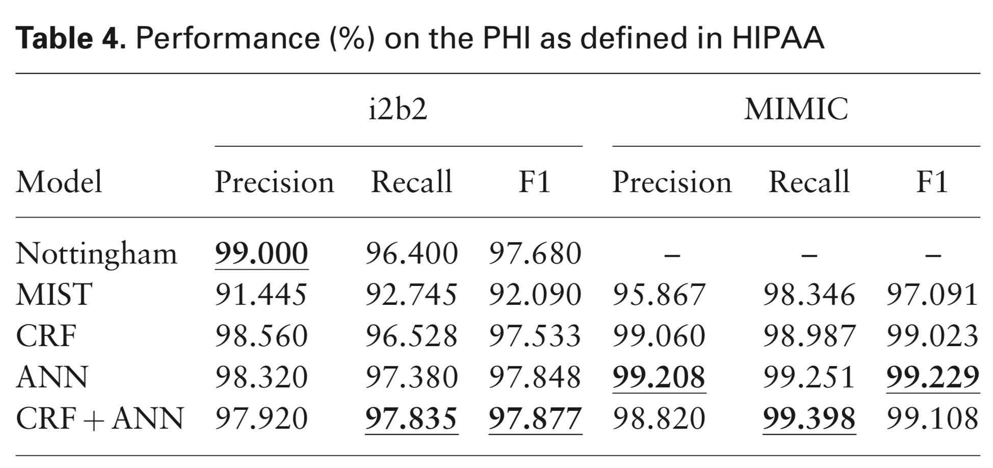
RNN Model Outperforms Previous Benchmarks
Notes:
Note that Nottingham incorporates expert system, dataset-specific elements

Slide 13
Running Example: Predict Hypoxemia during Surgery
Hypoxemia
SpO₂ ≤ 92%
Cardiac Arrest and Arrhythmias
Delirium and Decreased Cognitive Function
Infections and Poor Wound Healing
Notes:
BASED ON A COMBINATION OF INITIAL AND REAL-TIME / TIME-VARYING FEATURES AVAILABLE THROUGH THE ANESTHESIA INFORMATION MANAGEMENT SYSTEM (AIMS)
Hypoxaemia: decrease in SpO₂, that is, arterial blood oxygen saturation as measured by pulse oximetry, to a threshold value of 92% or lower
Real-time blood oxygen monitoring through pulse oximetry only allows anaesthesiologists to take reactive actions to minimize the duration of hypoxemic episodes after their occurrence
Hypoxaemia is associated with cardiac arrest, cardiac arrhythmias, post-operative infections and wound healing impairments, decreased cognitive function and delirium, and cerebral ischaemia through a number of metabolic pathways⁷. Despite the advent and use of pulse oximetry to continuously monitor blood oxygen saturation (SpO₂) during general and regional anaesthesia, hypoxaemia can neither be reliably predicted nor prevented at future time points

Slide 14
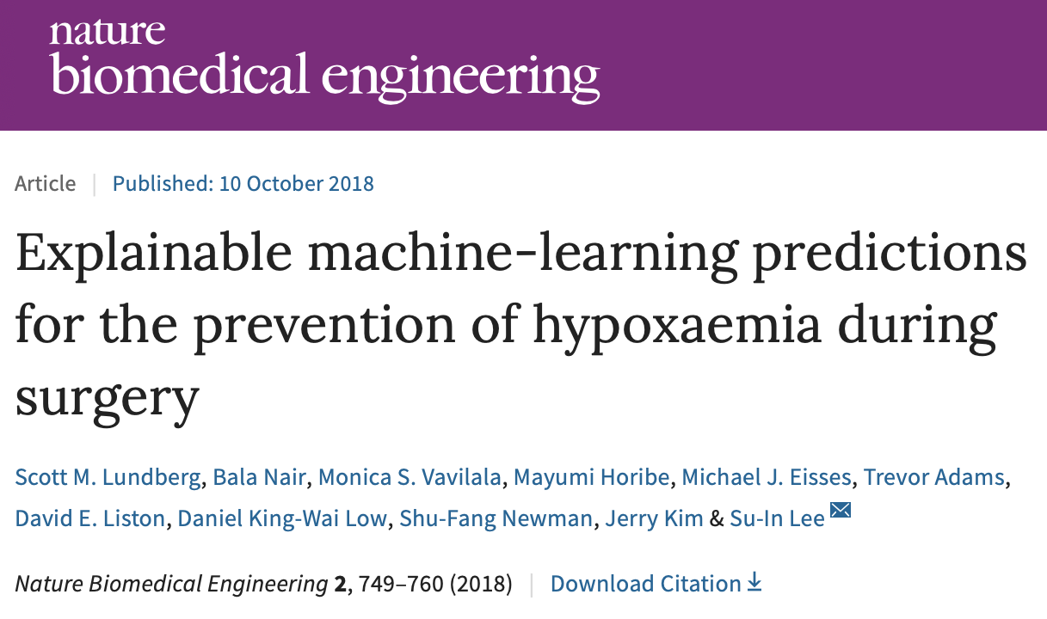

Slide 15
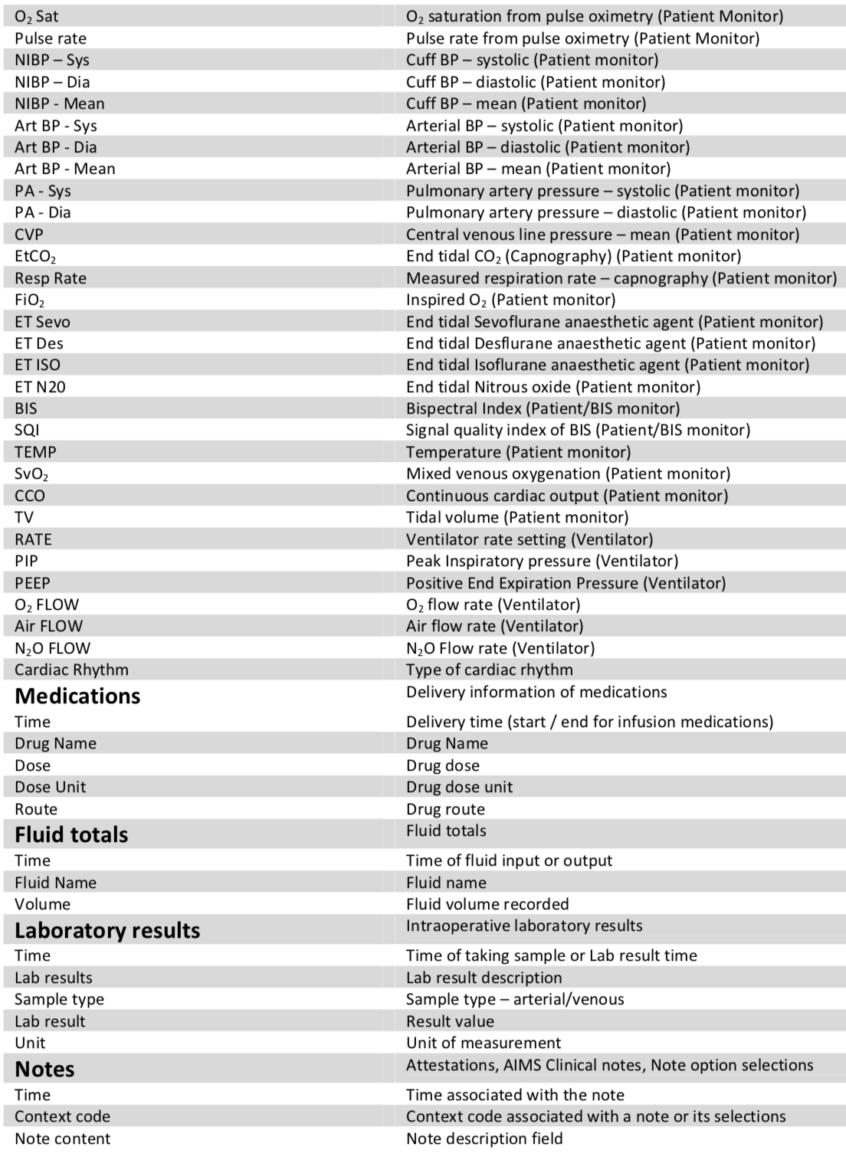
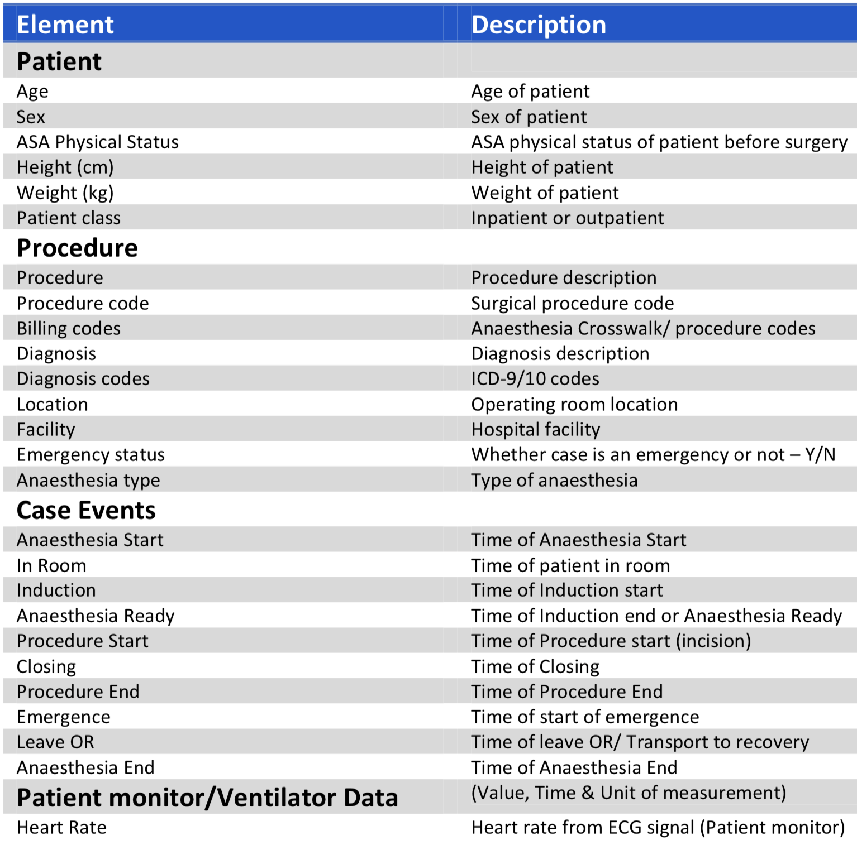
Data: Anesthesia Information Management System (AIMS)
3,797 static extracted features for each patient from more than 20 original static sources
an expanded superset of 3,905 real-time and static extracted features for each time point during anaesthesia care from the more than 20 original static sources as well as 45 different real-time data sources
Notes:
Note that more than 2,000 of the initial and intraoperative features represent words from text data sources.
Histograms summarizing the basic properties of the anaesthesia procedures used for training (y axes represent normalized procedure counts). Prescience was trained and evaluated using data from 53,126 procedures recorded at two hospitals over two years (representing 36,232 unique patients). In our dataset, 37.4% of adults aged 20 or over have a BMI of 30 or more, which is a close match to the US obesity rate of 37.9%
Healthy person.
Mild systemic disease. e.g. mild diabetes
Severe systemic disease, e.g. severe diabetes, intestinal obstruction,
Severe systemic disease that is a constant threat to life., e.g. cardiac decompensation
A moribund person who is not expected to survive without the operation, emergency for class 1 or 2
A declared brain-dead person whose organs are being removed for donor purposes, emergency for class 3 or 4

Slide 17
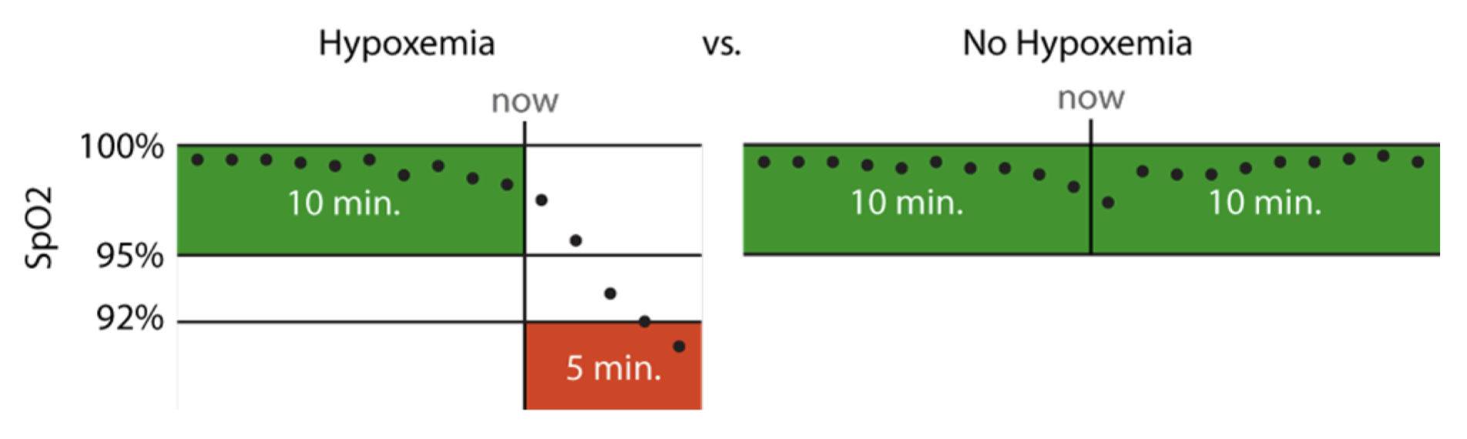
Prediction Tasks:
Initial Prediction: hypoxemia at any time based on static features
Real-time Prediction: hypoxemia in the next 5 minutes based on static features and real-time features collected up to that time point
Notes:
5 min window: long enough to allow an anaesthesiologist to intervene, but short enough to represent near-term risks that would benefit from immediate attention
This is actually what’s used for the anesthesiologist comparison
Model training was less strict

Slide 18
Initial Prediction
y, associated value or label
x, data/features for a subject or patient
End goal: predict y from x
Notes:
Suppose we have a vector of measurements (x)
Associated with those measurements is an outcome – or a label – or another measurement (y)
We’d like to make a prediction about (y) that is based on (x)
Maybe (y) is a home price. X is a bunch of information about that home, e.g. square footage, number of bedrooms, how old, neighborhood, school district. Let’s say we’d like to make an informed guess about the home price based on all that information. What we need is a predictive model.

Slide 19
Initial Prediction
Condition A
Systolic BP
Condition B
Height
Diastolic BP
Age
Weight
Sex
Hypoxemia
Goal: predict whether pt will become hypoxemic at any time during surgery
Notes:
ACUTE PHYSIOLOGY AND CHRONIC HEALTH EVALUATION
Predictive models are nothing new in medicine – APACHE, for instance – this is to predict mortality in ICU setting – has been around since the 70s.
In an ICU setting, we might want a model that takes a bunch of measurements about a patient -- their age (demographics), vitals, lab values, and some information about chronic health conditions and predicts their risk of dying (or likelihood of surviving…)

Slide 20
Real-time Prediction
Peak Pressure
Respiratory Rate
Tidal Volume
SpO2
Sevoflurane
Systolic BP
End-tidal CO2
Diastolic BP
Hypoxemia
Goal: predict whether pt will become hypoxemic during the next 5 minutes
Notes:
ACUTE PHYSIOLOGY AND CHRONIC HEALTH EVALUATION
Predictive models are nothing new in medicine – APACHE, for instance – this is to predict mortality in ICU setting – has been around since the 70s.
In an ICU setting, we might want a model that takes a bunch of measurements about a patient -- their age (demographics), vitals, lab values, and some information about chronic health conditions and predicts their risk of dying (or likelihood of surviving…)

Slide 21
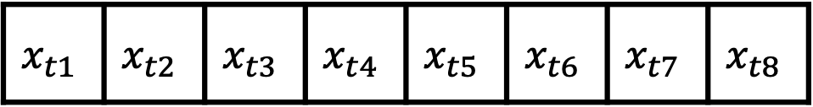
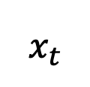
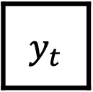
Real-time Prediction
$$x_{t}$$
$$x_{t1}$$ | $$x_{t2}$$ | $$x_{t3}$$ | $$x_{t4}$$ | $$x_{t5}$$ | $$x_{t6}$$ | $$x_{t7}$$ | $$x_{t8}$$
$$y_{t}$$
Peak Pressure
Respiratory Rate
Tidal Volume
SpO2
Sevoflurane
Systolic BP
End-tidal CO2
Diastolic BP
Hypoxemia
Goal: predict whether pt will become hypoxemic during the next 5 minutes
Notes:
ACUTE PHYSIOLOGY AND CHRONIC HEALTH EVALUATION
Predictive models are nothing new in medicine – APACHE, for instance – this is to predict mortality in ICU setting – has been around since the 70s.
In an ICU setting, we might want a model that takes a bunch of measurements about a patient -- their age (demographics), vitals, lab values, and some information about chronic health conditions and predicts their risk of dying (or likelihood of surviving…)

Slide 22
Real-time Prediction
$$x_{t}$$
$$x_{t1}$$ | $$x_{t2}$$ | $$x_{t3}$$ | $$x_{t4}$$ | $$x_{t5}$$ | $$x_{t6}$$ | $$x_{t7}$$ | $$x_{t8}$$
$$y_{t}$$
Goal: predict whether pt will become hypoxemic during the next 5 minutes
Notes:
ACUTE PHYSIOLOGY AND CHRONIC HEALTH EVALUATION
Predictive models are nothing new in medicine – APACHE, for instance – this is to predict mortality in ICU setting – has been around since the 70s.
In an ICU setting, we might want a model that takes a bunch of measurements about a patient -- their age (demographics), vitals, lab values, and some information about chronic health conditions and predicts their risk of dying (or likelihood of surviving…)

Slide 23
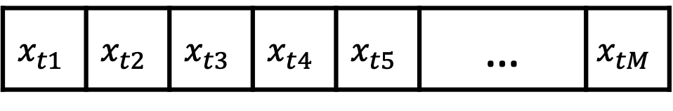
Real-time Prediction
$$x_{t}$$
$$x_{t1}$$ | $$x_{t2}$$ | $$x_{t3}$$ | $$x_{t4}$$ | $$x_{t5}$$ | … | $$x_{tM}$$
$$y_{t}$$
Goal: predict whether pt will become hypoxemic during the next 5 minutes
Notes:
ACUTE PHYSIOLOGY AND CHRONIC HEALTH EVALUATION
Predictive models are nothing new in medicine – APACHE, for instance – this is to predict mortality in ICU setting – has been around since the 70s.
In an ICU setting, we might want a model that takes a bunch of measurements about a patient -- their age (demographics), vitals, lab values, and some information about chronic health conditions and predicts their risk of dying (or likelihood of surviving…)

Slide 24
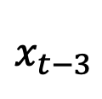
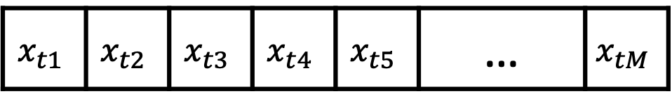
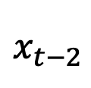
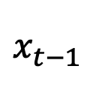
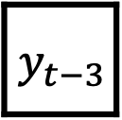
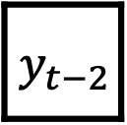
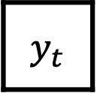
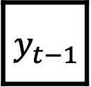
Real-time Prediction
$$x_{t}$$
$$x_{t1}$$ | $$x_{t2}$$ | $$x_{t3}$$ | $$x_{t4}$$ | $$x_{t5}$$ | … | $$x_{tM}$$
$$y_{t}$$
$$x_{t−1}$$
 |  |  |  |  | …
$$y_{t−1}$$
$$x_{t−2}$$
 |  |  |  |  | …
$$y_{t−2}$$
$$x_{t−3}$$
 |  |  |  |  | …
$$y_{t−3}$$
Goal: predict whether pt will become hypoxemic during the next 5 minutes
Notes:
ACUTE PHYSIOLOGY AND CHRONIC HEALTH EVALUATION
Predictive models are nothing new in medicine – APACHE, for instance – this is to predict mortality in ICU setting – has been around since the 70s.
In an ICU setting, we might want a model that takes a bunch of measurements about a patient -- their age (demographics), vitals, lab values, and some information about chronic health conditions and predicts their risk of dying (or likelihood of surviving…)

Slide 25
Real-time Prediction
$$x_{t}$$
$$x_{t1}$$ | $$x_{t2}$$ | $$x_{t3}$$ | $$x_{t4}$$ | $$x_{t5}$$ | … | $$x_{tM}$$
$$y_{t}$$
$$x_{t−1}$$
 |  |  |  |  | …
$$x_{t−2}$$
 |  |  |  |  | …
$$x_{t−3}$$
 |  |  |  |  | …
Goal: predict whether pt will become hypoxemic during the next 5 minutes
Notes:
ACUTE PHYSIOLOGY AND CHRONIC HEALTH EVALUATION
Predictive models are nothing new in medicine – APACHE, for instance – this is to predict mortality in ICU setting – has been around since the 70s.
In an ICU setting, we might want a model that takes a bunch of measurements about a patient -- their age (demographics), vitals, lab values, and some information about chronic health conditions and predicts their risk of dying (or likelihood of surviving…)

Slide 26
Goal: combine $x_{t}, …,x_{t−τ}$ into a fixed-length vector
$$x_{t}$$
$$x_{t1}$$ | $$x_{t2}$$ | $$x_{t3}$$ | $$x_{t4}$$ | $$x_{t5}$$ | … | $$x_{tM}$$
$$y_{t}$$
$$x_{t−1}$$
 |  |  |  |  | …
$$x_{t−2}$$
 |  |  |  |  | …
$$x_{t−3}$$
 |  |  |  |  | …
Goal: predict whether pt will become hypoxemic during the next 5 minutes
Notes:
ACUTE PHYSIOLOGY AND CHRONIC HEALTH EVALUATION
Predictive models are nothing new in medicine – APACHE, for instance – this is to predict mortality in ICU setting – has been around since the 70s.
In an ICU setting, we might want a model that takes a bunch of measurements about a patient -- their age (demographics), vitals, lab values, and some information about chronic health conditions and predicts their risk of dying (or likelihood of surviving…)

Slide 27
Goal: combine $x_{t}, …,x_{t−τ}$ into a fixed-length vector
$$x_{t}$$
$$x_{t1}$$ | $$x_{t2}$$ | $$x_{t3}$$ | $$x_{t4}$$ | $$x_{t5}$$ | … | $$x_{tM}$$
$$y_{t}$$
$$x_{t−1}$$
 |  |  |  |  | …
$$x_{t−2}$$
 |  |  |  |  | …
$$x_{t−3}$$
 |  |  |  |  | …
Goal: predict whether pt will become hypoxemic during the next 5 minutes
Notes:
ACUTE PHYSIOLOGY AND CHRONIC HEALTH EVALUATION
Predictive models are nothing new in medicine – APACHE, for instance – this is to predict mortality in ICU setting – has been around since the 70s.
In an ICU setting, we might want a model that takes a bunch of measurements about a patient -- their age (demographics), vitals, lab values, and some information about chronic health conditions and predicts their risk of dying (or likelihood of surviving…)

Slide 28
Recall: Convert variable-length sentence to fixed-length vector with max and average operations
This is a sentence
avg
AVG

Slide 29
Goal: combine $x_{t}, …,x_{t−τ}$ into a fixed-length vector
$$x_{t}$$
$$x_{t1}$$ | $$x_{t2}$$ | $$x_{t3}$$ | $$x_{t4}$$ | $$x_{t5}$$ | … | $$x_{tM}$$
$$y_{t}$$
$$x_{t−1}$$
 |  |  |  |  | …
$$x_{t−2}$$
 |  |  |  |  | …
$$x_{t−3}$$
 |  |  |  |  | …
Summary Statistic A
Goal: predict whether pt will become hypoxemic during the next 5 minutes
Notes:
ACUTE PHYSIOLOGY AND CHRONIC HEALTH EVALUATION
Predictive models are nothing new in medicine – APACHE, for instance – this is to predict mortality in ICU setting – has been around since the 70s.
In an ICU setting, we might want a model that takes a bunch of measurements about a patient -- their age (demographics), vitals, lab values, and some information about chronic health conditions and predicts their risk of dying (or likelihood of surviving…)

Slide 30
Goal: combine $x_{t}, …,x_{t−τ}$ into a fixed-length vector
$$x_{t}$$
$$x_{t1}$$ | $$x_{t2}$$ | $$x_{t3}$$ | $$x_{t4}$$ | $$x_{t5}$$ | … | $$x_{tM}$$
$$y_{t}$$
$$x_{t−1}$$
 |  |  |  |  | …
$$x_{t−2}$$
 |  |  |  |  | …
$$x_{t−3}$$
 |  |  |  |  | …
Summary Statistic A
Goal: predict whether pt will become hypoxemic during the next 5 minutes
Notes:
ACUTE PHYSIOLOGY AND CHRONIC HEALTH EVALUATION
Predictive models are nothing new in medicine – APACHE, for instance – this is to predict mortality in ICU setting – has been around since the 70s.
In an ICU setting, we might want a model that takes a bunch of measurements about a patient -- their age (demographics), vitals, lab values, and some information about chronic health conditions and predicts their risk of dying (or likelihood of surviving…)

Slide 31
Goal: combine $x_{t}, …,x_{t−τ}$ into a fixed-length vector
$$x_{t}$$
$$x_{t1}$$ | $$x_{t2}$$ | $$x_{t3}$$ | $$x_{t4}$$ | $$x_{t5}$$ | … | $$x_{tM}$$
$$y_{t}$$
$$x_{t−1}$$
 |  |  |  |  | …
$$x_{t−2}$$
 |  |  |  |  | …
$$x_{t−3}$$
 |  |  |  |  | …
Summary Statistic A
Goal: predict whether pt will become hypoxemic during the next 5 minutes
Notes:
ACUTE PHYSIOLOGY AND CHRONIC HEALTH EVALUATION
Predictive models are nothing new in medicine – APACHE, for instance – this is to predict mortality in ICU setting – has been around since the 70s.
In an ICU setting, we might want a model that takes a bunch of measurements about a patient -- their age (demographics), vitals, lab values, and some information about chronic health conditions and predicts their risk of dying (or likelihood of surviving…)

Slide 32
Goal: combine $x_{t}, …,x_{t−τ}$ into a fixed-length vector
$$x_{t}$$
$$x_{t1}$$ | $$x_{t2}$$ | $$x_{t3}$$ | $$x_{t4}$$ | $$x_{t5}$$ | … | $$x_{tM}$$
$$y_{t}$$
$$x_{t−1}$$
 |  |  |  |  | …
$$x_{t−2}$$
 |  |  |  |  | …
$$x_{t−3}$$
 |  |  |  |  | …
Summary Statistic B
Goal: predict whether pt will become hypoxemic during the next 5 minutes
Notes:
ACUTE PHYSIOLOGY AND CHRONIC HEALTH EVALUATION
Predictive models are nothing new in medicine – APACHE, for instance – this is to predict mortality in ICU setting – has been around since the 70s.
In an ICU setting, we might want a model that takes a bunch of measurements about a patient -- their age (demographics), vitals, lab values, and some information about chronic health conditions and predicts their risk of dying (or likelihood of surviving…)

Slide 33
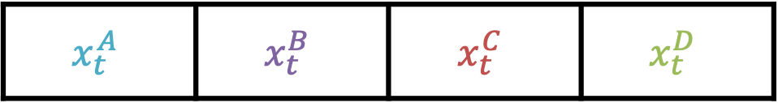
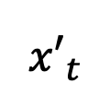
Real-time Prediction
$${x′}_{t}$$
$$x_{t}^{A}$$ | $$x_{t}^{B}$$ | $$x_{t}^{C}$$ | $$x_{t}^{D}$$
$$y_{t}$$
Vector of length $4M$ with summary stats A – D at time $t$
Goal: predict whether pt will become hypoxemic during the next 5 minutes
Notes:
ACUTE PHYSIOLOGY AND CHRONIC HEALTH EVALUATION
Predictive models are nothing new in medicine – APACHE, for instance – this is to predict mortality in ICU setting – has been around since the 70s.
In an ICU setting, we might want a model that takes a bunch of measurements about a patient -- their age (demographics), vitals, lab values, and some information about chronic health conditions and predicts their risk of dying (or likelihood of surviving…)

Slide 34
Summary Statistics
Current value
Average and/or extreme values
Cumulative sums
Recent trends
Measurement frequency or time since last measurement
Notes:
Give examples of these – where each one might make sense

Slide 35
In the Hypoxemia Paper:
We summarized these unevenly sampled time-registered data into a fixed-length feature vector at any point in time using several complementary methods:
Last value, which is zero before any data is recorded and the value of the data afterwards.
Exponentially decaying weighted average and variance estimates using multiple decay rates (6 sec, 1 min, 5 min)
Exponentially decaying sum and a time since the last measurement. For drug dose data (decay rates of 5 min and 1 hour)
Notes:
Make the connection to surgery project here

Slide 36
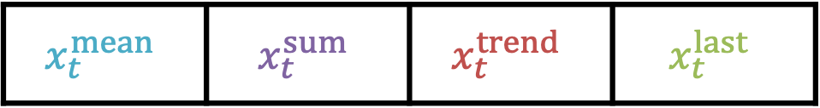
Real-time Prediction
$${x′}_{t}$$
$$x_{t}^{mean}$$ | $$x_{t}^{sum}$$ | $$x_{t}^{trend}$$ | $$x_{t}^{last}$$
$$y_{t}$$
Vector of length $4M$ with summary stats A – D at time $t$
Goal: predict whether pt will become hypoxemic during the next 5 minutes
Notes:
ACUTE PHYSIOLOGY AND CHRONIC HEALTH EVALUATION
Predictive models are nothing new in medicine – APACHE, for instance – this is to predict mortality in ICU setting – has been around since the 70s.
In an ICU setting, we might want a model that takes a bunch of measurements about a patient -- their age (demographics), vitals, lab values, and some information about chronic health conditions and predicts their risk of dying (or likelihood of surviving…)

Slide 37




Now we can use logistic regression (or any other classifier)
$$p_{t}=p(y_{t}=1|{x′}_{t})$$
$$σ$$
z_{t}
$${x′}_{t}$$
$$x_{t}^{mean}$$ | $$x_{t}^{sum}$$ | $$x_{t}^{trend}$$ | $$x_{t}^{last}$$
Notes:
ACUTE PHYSIOLOGY AND CHRONIC HEALTH EVALUATION
Predictive models are nothing new in medicine – APACHE, for instance – this is to predict mortality in ICU setting – has been around since the 70s.
In an ICU setting, we might want a model that takes a bunch of measurements about a patient -- their age (demographics), vitals, lab values, and some information about chronic health conditions and predicts their risk of dying (or likelihood of surviving…)

Slide 38
Contrast with text summary stats
Cannot look at future values
Window length is fixed

Slide 39
Challenges
Missing values
Inconsistent or unequal measurement intervals
Appropriate summary stats vary between measurement types
Notes:
The interval problem has been solved by GP

Slide 40




Prediction task A: one label per series
$$x_{T}$$
$$x_{t1}$$ | $$x_{t2}$$ | $$x_{t3}$$ | $$x_{t4}$$ | $$x_{t5}$$ | … | $$x_{tM}$$
$$y$$
$$x_{T−1}$$
 |  |  |  |  | …
…
…
$$x_{1}$$
 |  |  |  |  | …
Goal: predict whether pt will become hypoxemic at any time during surgery
Notes:
ACUTE PHYSIOLOGY AND CHRONIC HEALTH EVALUATION
Predictive models are nothing new in medicine – APACHE, for instance – this is to predict mortality in ICU setting – has been around since the 70s.
In an ICU setting, we might want a model that takes a bunch of measurements about a patient -- their age (demographics), vitals, lab values, and some information about chronic health conditions and predicts their risk of dying (or likelihood of surviving…)

Slide 41



Prediction task B: one label per time step
$$x_{T}$$
$$x_{t1}$$ | $$x_{t2}$$ | $$x_{t3}$$ | $$x_{t4}$$ | $$x_{t5}$$ | … | $$x_{tM}$$
$$y_{T}$$
$$x_{T−1}$$
 |  |  |  |  | …
$$y_{T−1}$$
…
…
$$x_{1}$$
 |  |  |  |  | …
$$y_{1}$$
Goal: predict whether pt will become hypoxemic during the next 5 minutes
Notes:
ACUTE PHYSIOLOGY AND CHRONIC HEALTH EVALUATION
Predictive models are nothing new in medicine – APACHE, for instance – this is to predict mortality in ICU setting – has been around since the 70s.
In an ICU setting, we might want a model that takes a bunch of measurements about a patient -- their age (demographics), vitals, lab values, and some information about chronic health conditions and predicts their risk of dying (or likelihood of surviving…)

Slide 42
Prediction task B: one label per time step
$$x_{T}$$
$$x_{t1}$$ | $$x_{t2}$$ | $$x_{t3}$$ | $$x_{t4}$$ | $$x_{t5}$$ | … | $$x_{tM}$$
$$y_{T}$$
$$x_{T−1}$$
 |  |  |  |  | …
$$y_{T−1}$$
…
…
$$x_{1}$$
 |  |  |  |  | …
$$y_{1}$$
Goal: predict whether pt will become hypoxemic during the next 5 minutes
Notes:
ACUTE PHYSIOLOGY AND CHRONIC HEALTH EVALUATION
Predictive models are nothing new in medicine – APACHE, for instance – this is to predict mortality in ICU setting – has been around since the 70s.
In an ICU setting, we might want a model that takes a bunch of measurements about a patient -- their age (demographics), vitals, lab values, and some information about chronic health conditions and predicts their risk of dying (or likelihood of surviving…)

Slide 43
Prediction task B: one label per time step
$$x_{T}$$
$$x_{t1}$$ | $$x_{t2}$$ | $$x_{t3}$$ | $$x_{t4}$$ | $$x_{t5}$$ | … | $$x_{tM}$$
$$y_{T}$$
$$x_{T−1}$$
 |  |  |  |  | …
$$y_{T−1}$$
…
…
$$x_{1}$$
 |  |  |  |  | …
$$y_{1}$$
Goal: predict whether pt will become hypoxemic during the next 5 minutes
Notes:
ACUTE PHYSIOLOGY AND CHRONIC HEALTH EVALUATION
Predictive models are nothing new in medicine – APACHE, for instance – this is to predict mortality in ICU setting – has been around since the 70s.
In an ICU setting, we might want a model that takes a bunch of measurements about a patient -- their age (demographics), vitals, lab values, and some information about chronic health conditions and predicts their risk of dying (or likelihood of surviving…)

Slide 44
Model Development & Results
Hypoxemia Detection
Notes:
Data had very low missingness
Used very simple imputation / alignment strategy
Now: how to model?

Slide 45
Test / Validation / Train
Initial prediction:
Training: 42,420 procedures (each a single surgical case)
Validation: 5,649 procedures
Test: 5,057 procedures
Real-time prediction:
Training: 8,087,476 per-minute time points
Validation: 1,053,629 per-minute time points
Test: 963,674 per-minute time points
All time points from the same procedure were included in the same sample set and no missing data imputation was performed.
“To ensure that there was no bias towards the final test set, the test data was initially compressed and left compressed until method development was completed.”

Slide 46



Their Classifier: Gradient Boosting Machine
Step 1: Fit initial model
Step 2: Fit a second model to the residuals
(or pseudo-residuals)
Step 3: Repeat (2)…
$$y=f_{0}\left(x\right)+ε_{0}$$
$ε_{0}=f_{1}\left(x\right)+$ $ε_{1}$
$$\hat{y}=\sum_{i=1}^{M}{f_{i}\left(x\right)}$$
GBM for least squares regression
Notes:
Note… it IS the residuals if we’re using the summed squared error loss, in which case residuals are the gradient of the loss
Otherwise it’s pseudo-residuals
Usually decision trees are the base model

Slide 47
Their Model: Gradient Boosting Machine
Notes:
Note that this isn’t all that important… could be any model
SVM, MLP, etc. They don’t compare to MLP.
The point: it’s nonlinear

Slide 48


Comparison to Alternatives
Initial Prediction
Real-time Prediction

Slide 49
Comparison to Experts
For initial risk prediction:
Anaesthesiologists performed significantly better with Prescience (AUC = 0.76 versus 0.60; P < 0.0001)
Prescience performed better in a direct comparison with anaesthesiologists (AUC = 0.83; P < 0.0001)
For intraoperative real-time (next 5 min) risk prediction:
Anaesthesiologists (AUC = 0.66) again performed better with Prescience (AUC = 0.78; P < 0.0001)
Prescience alone outperformed anaesthesiologists predictions (AUC = 0.81; P < 0.0001)
Notes:
anaesthesiologists were asked to provide a relative risk of hypoxaemia compared to a normal acceptable risk, for example, 0.01 for one-hundredth of the normal risk or 3.4 for 3.4 times the normal risk. These relative risks were then used to calculate standard receiver operating characteristic (ROC) curves averaged over five anaesthesiologists
Light colored lines are individuals; dark lines are average
As usual, highlight false alarm / missing tradeoff, which can be calibrated
P values were computed using bootstrap resampling over the tested time points while measuring the difference in area between the curves
To avoid the scenario in which an anaesthesiologist is tested twice on the same prediction task—one with and the other without Prescience, we created replicate test sets by dividing the prediction tasks into two groups of similar size: tasks for initial prediction (100 and 98 tasks) and tasks for real-time prediction (260 and 263 tasks). Each of the five recruited anaesthesiologists was assigned to receive Prescience’s assistance in one of these two replicate test sets (see Methods)
The anaesthesiologist test time points for hypoxaemia were chosen to be drops in SpO₂ (Supplementary Fig. 1) with a preceding period of stable and normal SpO₂. However, the entire dataset also included easier-to-predict hypoxemic events that follow previous SpO₂ drops and decreasing SpO₂ trends. For the entire dataset, Prescience achieves a higher real-time prediction area under the ROC curve of 0.90 (as opposed to 0.81 in Fig. 3b; see Supplementary Fig. 3), and when a larger training dataset was used, the area under the real-time prediction ROC curve rose to 0.92 (Supplementary Fig. 9).
If we extrapolate the real-time results to the 30 million annual surgeries in the United States under the assumption that doctors anticipate 15% of hypoxemic events while SpO₂ is still ≥95%, then with the assistance of Prescience they may be able to anticipate 30% of these events, or approximately 2.4 million additional episodes of hypoxaemia annually. Given that 20% of the risk predicted by Prescience is based on drugs and settings under the control of the anaesthesiologist (Supplementary Table 5), a large portion of these predicted events may benefit from early intervention.
The anaesthesiologists consulted had experience after residency ranging from 3 to 26 years (median = 7 yr) and were all actively practising at University of Washington Medical Center, VA Puget Sound Health System or Seattle Children’s hospital

Slide 50
Is this a fair comparison?
Training examples are episodes of hypoxemia that were not prevented during surgery
Expert comparison:
the expert is predicting likelihood hypoxemic episodes, some of which were prevented
the model has learned to predict hypoxemic episodes that couldn’t be avoided

Slide 51
Interpretable Predictions

Slide 52
Highlight Feature Importance
Notes:
A wide variety of data sources were used to build a predictive model of hypoxaemia events. An explanation (overlaid) is then built for each prediction. Pink features have values that increased risk, whereas green features decreased hypoxaemia risk. The combination of the impacts of all features is the predicted Prescience risk; in this case, the odds are 2.4 × higher than normal. Each feature impact value represents the change in risk when the value of that feature is known versus unknown. Qualitative terms such as ‘low’ or ‘high’ are based on the distribution of a feature value in our dataset.

Slide 53
Cumulative Effect of Features
Notes:
Authors have a NeurIPS 2017 paper on Shapley values
An hour of data from a procedure is shown. a, Explained risk of hypoxaemia in the next five minutes. b, Plot of the explained risks evolving over time. This plot is equivalent to rotating a by 90° and stacking the risk explanations for every time point horizontally. c, Subset of the patient data for this procedure, plotted both before and after the current time point. Procedure events and drug doses are shown at the top above the time-series data, static patient data are not shown for the sake of patient privacy. NSR, normal sinus rhythm; PEEP, positive end-expiratory pressure.
For some of these features it is helpful to tag them with indicators of how they relate to hypoxaemia risk before final deployment in an operating room. This can help anaesthesiologists to quickly see non-obvious connections with patient physiology, such as how the muscle relaxant succinylcholine in Fig. 4 does not represent a direct causal impact on hypoxaemia, but rather is a proxy that captures the risk from a potentially difficult airway or full stomach
Shapley Values:
additivity: they all add up to explain deviation between mean prediction and expected value of the function
Monotonicity
Depends on training a distinct model for each feature (with that feature removed to see how model would change if it were absent)

Slide 54
Model Predictions vs Physician Predictions
Notes:
a,b, Importance estimates assigned by the Prescience model (blue) and anaesthesiologists (green) to the top features in both the initial (a) and real-time (b) prediction. The importance of features is measured as the estimated percentage of the model’s prediction accuracy that is due to that feature. The numbers presented to the left of the imputed anaesthesiologist importance estimates are feature rankings from a consensus of anaesthesiologist responses about which features they believed would be important (Supplementary Tables 2 and 3). Note that the second (lung disease) and fourth (asthma) features, as ranked by anaesthesiologists for initial prediction (Supplementary Table 2), were not in the top Prescience features. The sixth ranked feature by anaesthesiologists for real-time prediction corresponds to two Prescience data sources. The quantitative anaesthesiologist feature-importance estimates were estimated using 20 bootstrapped models trained to mimic the predictions of an anaesthesiologist when unassisted by Prescience. ORIF, open reduction internal fixation.

Slide 55
Sensitivity Analysis
These partial dependence plots show the change in hypoxemia risk for all values of a given feature. The grey histograms on each plot show the distribution of values for that feature in the validation dataset. The lighter coloured lines represent model variability from bootstrap resampling of the training data, the dark lines represent the average of the bootstrap runs.

Slide 56
Alternative Approach: RNN

Slide 57













Recurrent Neural Network
Sequence of time-varying
measurements
Model-Predicted
hypoxemia
$$h_{t}$$
Neural
Network
$$h_{t}$$
$$x_{t}$$
Softmax
$$y_{t}$$
$$h_{t−1}$$
Neural
Network
$$h_{t−1}$$
$$x_{t−1}$$
Softmax
$$y_{t−1}$$
$$h_{t−2}$$
Neural
Network
$$h_{t−2}$$
$$x_{t−2}$$
Softmax
$$y_{t−2}$$
$$h_{t−3}$$
Notes:
Have a network that’s made to deal with a sequence of vectors
On this slide: what are the inputs, what are the outputs, what are the different blocks
W for word
H for hidden
Here we’re training

Slide 58

Recurrent Neural Network
Sequence of time-varying
measurements
Learned summary stats for time $t$
Model-Predicted
hypoxemia
$$h_{t}$$
Neural
Network
$$h_{t}$$
$$x_{t}$$
Softmax
$$y_{t}$$
$$h_{t−1}$$
Neural
Network
$$h_{t−1}$$
$$x_{t−1}$$
Softmax
$$y_{t−1}$$
$$h_{t−2}$$
Neural
Network
$$h_{t−2}$$
$$x_{t−2}$$
Softmax
$$y_{t−2}$$
$$h_{t−3}$$
Notes:
Prob don’t do it here because of their feature importance idea?
-> have to train an ensemble of models

Slide 59
RNN or CNN?
Key advantage of RNN: able to handle variable-length sequences
Key disadvantage of RNN: difficulty with long-term dependencies
Recent work: CNNs that can handle variable-length sequences

Slide 60

Convolutional Architecture for Time Series (uses “dilated” convolutions)
A dilated causal convolution with dilation factors $d=1, 2, 4$and filter size $k=3$. The receptive field is able to cover all values from the input sequence.

Slide 61

CNNs for Sequences: (Bai et al, 2018)
Notes:
“Our results indicate that a simple convolutional archi- tecture outperforms canonical recurrent networks such as LSTMs across a diverse range of tasks and datasets, while demonstrating longer effective memory.”

Slide 62
Stacked RNN & Transformer
Hierarchical architectures
The latter is based on “self-attention”: determine which words modify a given word, and how

